Slide 1
BARMAN
BACKUP AND RECOVERY MANAGER

Slide 2
Barman (Backup and Recovery Manager) is an open-source administration tool for disaster recovery of PostgreSQL servers written in Python. It allows your organisation to perform remote backups of multiple servers in business critical environments to reduce risk and help DBAs during the recovery phase.
Barman is distributed under GNU GPL 3 and maintained by 2ndQuadrant, a platinum sponsor of the PostgreSQL project.

Slide 3
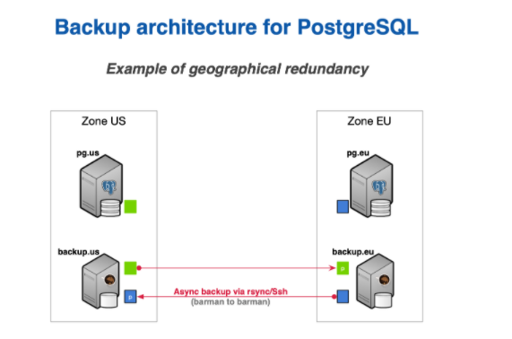

Slide 4
One Barman, many PostgreSQL servers
Another relevant feature that was first introduced by Barman is support for multiple servers. Barman can store backup data coming from multiple PostgreSQL instances, even with different versions, in a centralised way.

Slide 5
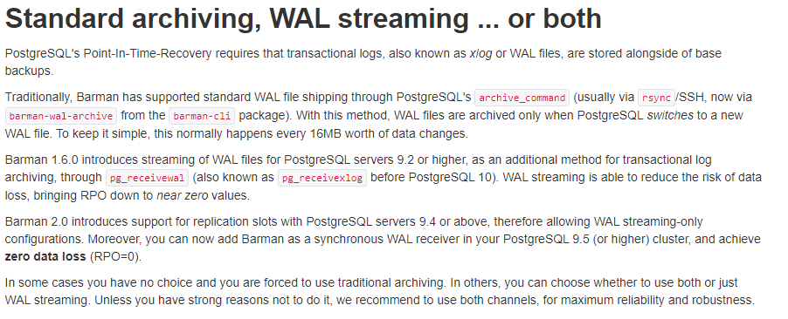
Two typical scenarios for backups
In order to make life easier for you, below we summarise the two most typical scenarios for a given PostgreSQL server in Barman.
Bear in mind that this is a decision that you must make for every single server that you decide to back up with Barman. This means that you can have heterogeneous setups within the same installation.
As mentioned before, we will only worry about the PostgreSQL server (pg) and the Barman server (backup). However, in real life, your architecture will most likely contain other technologies such as repmgr, pgBouncer, Nagios/Icinga, and so on.

Slide 6
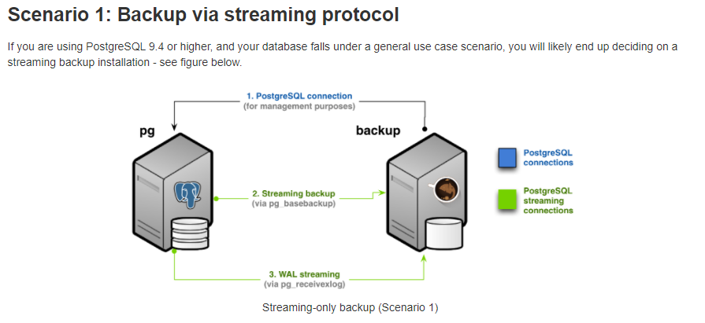

Slide 7
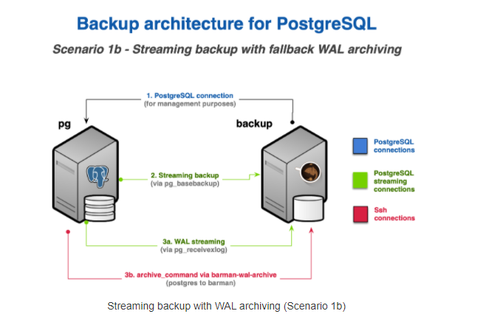

Slide 8
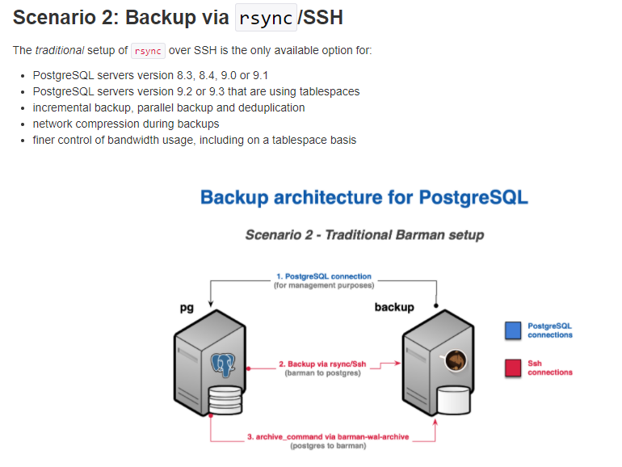

Slide 9
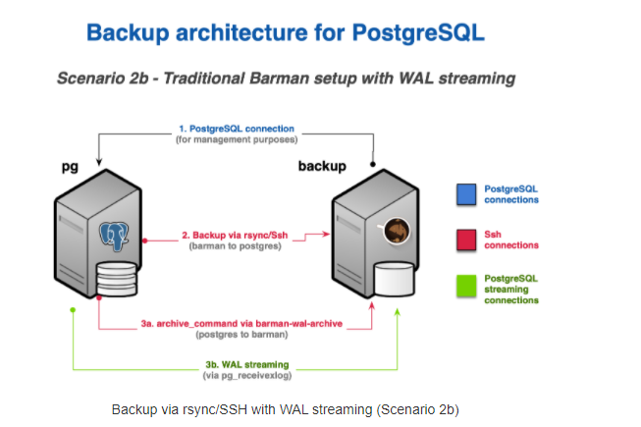

Slide 10
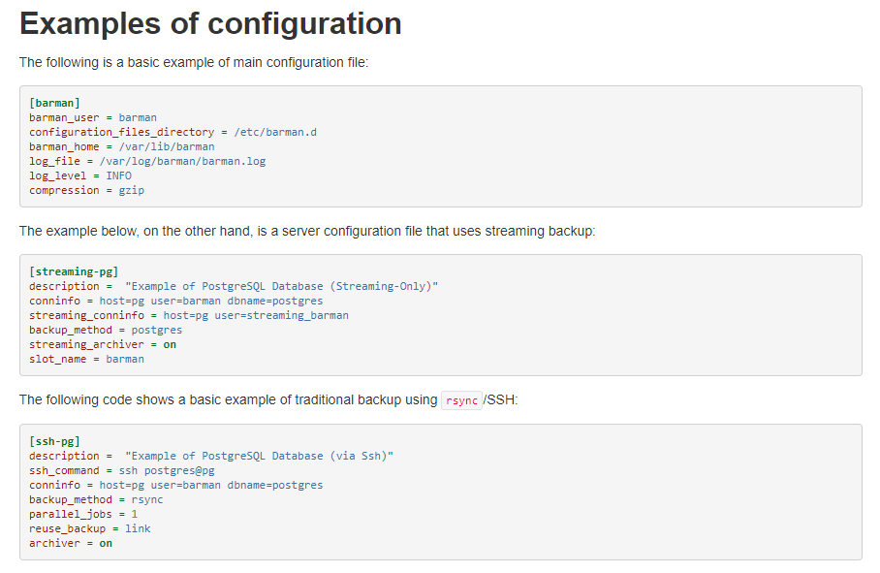

Slide 11
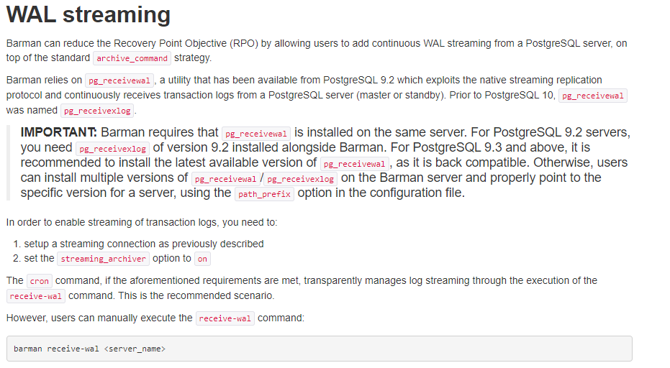

Slide 12
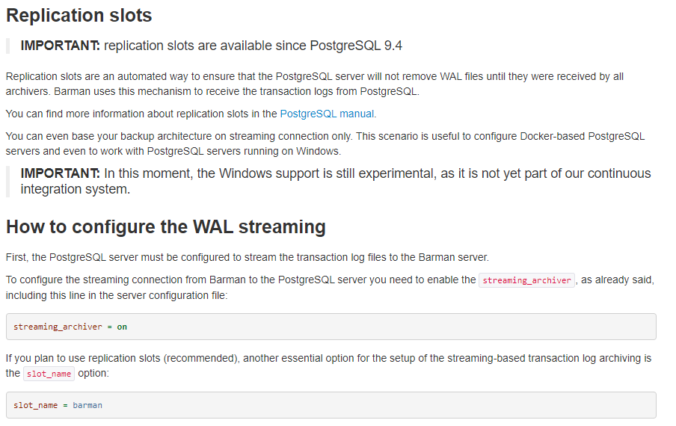

Slide 13
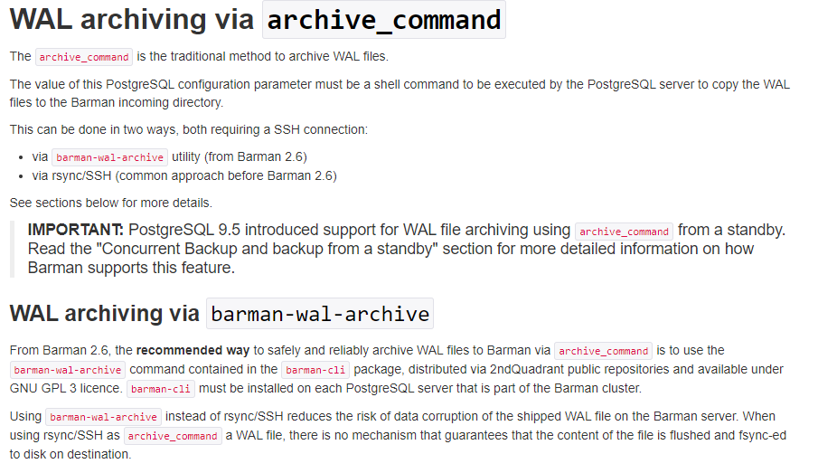

Slide 14
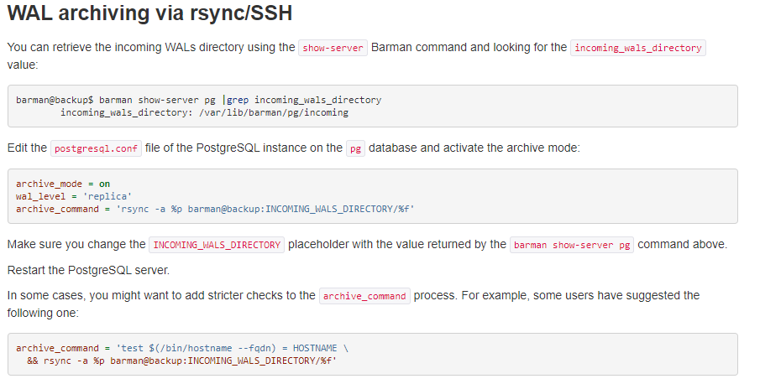

Slide 15
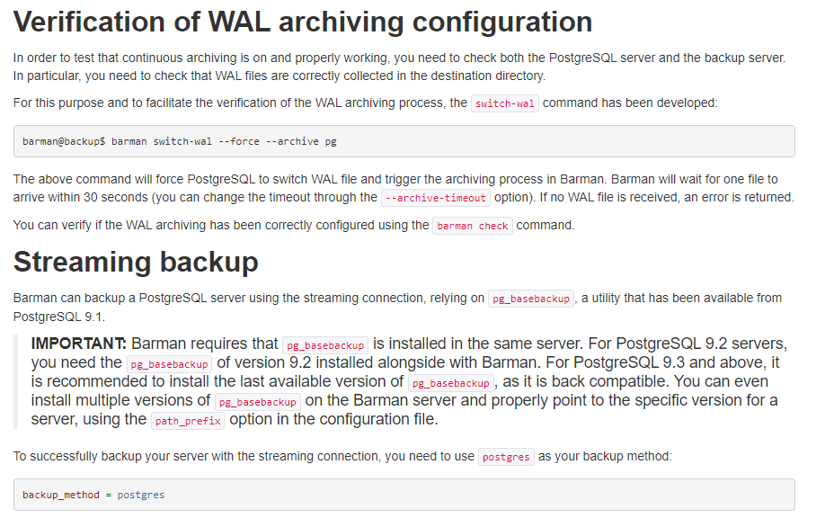

Slide 16
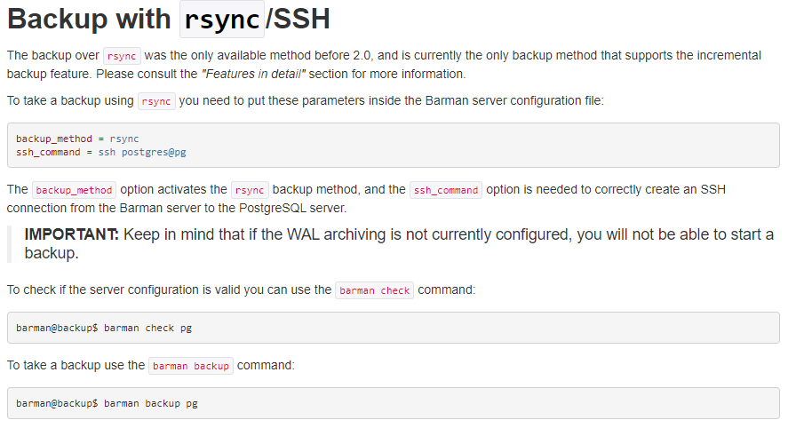

Slide 17
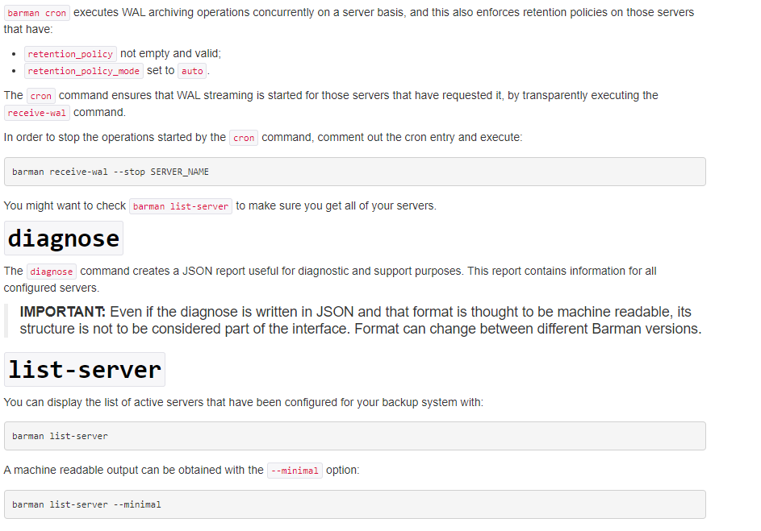

Slide 18
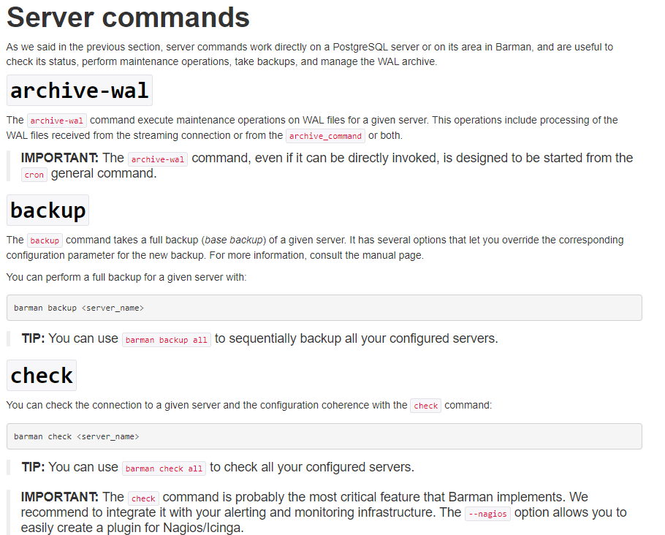

Slide 19
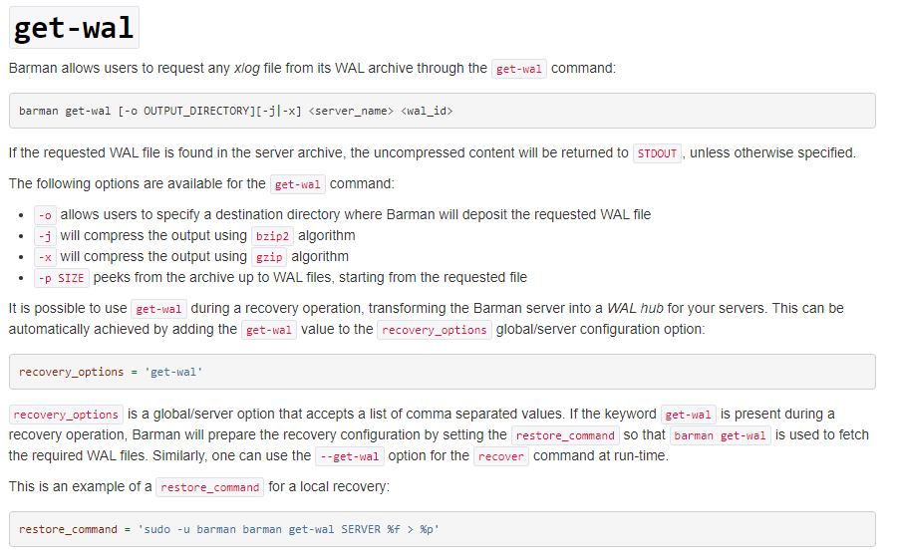

Slide 20
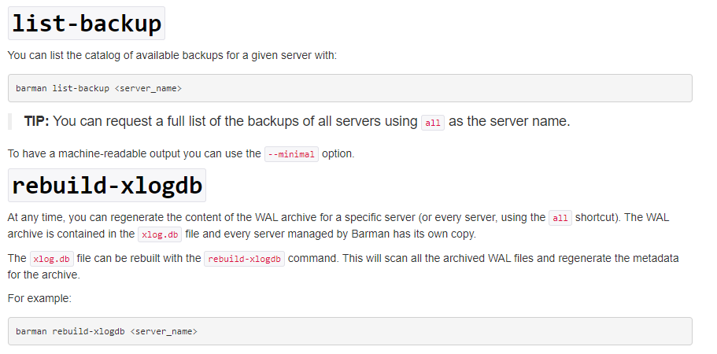

Slide 21
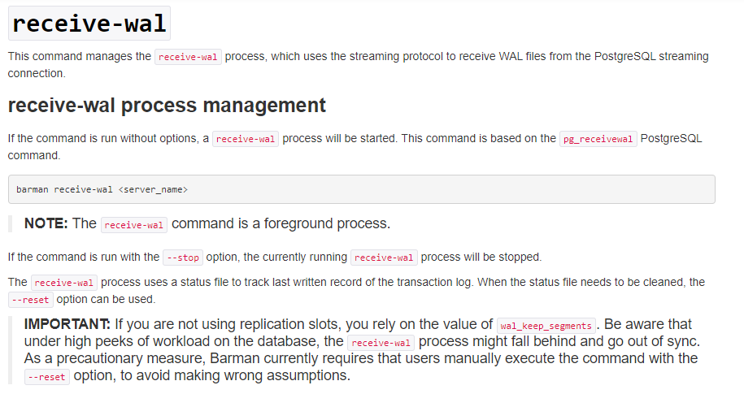

Slide 22
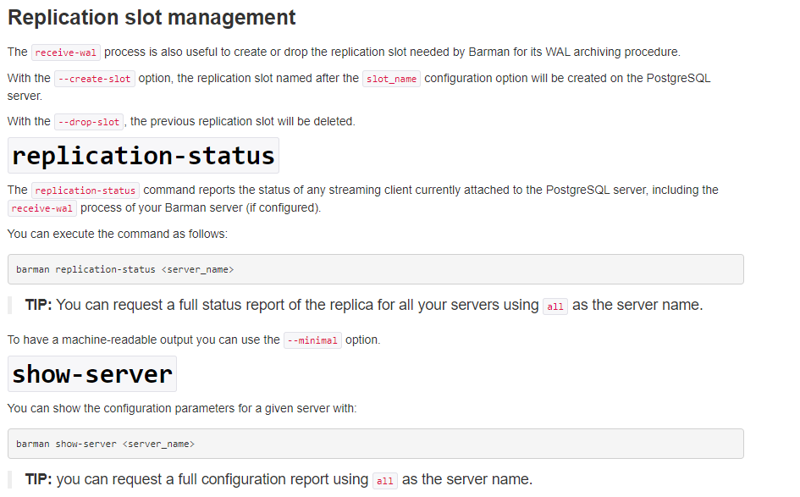

Slide 23
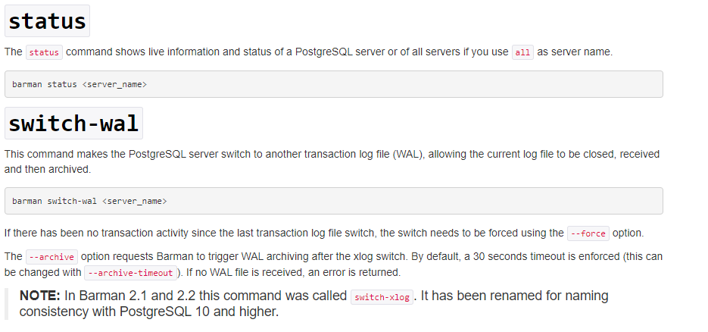

Slide 24
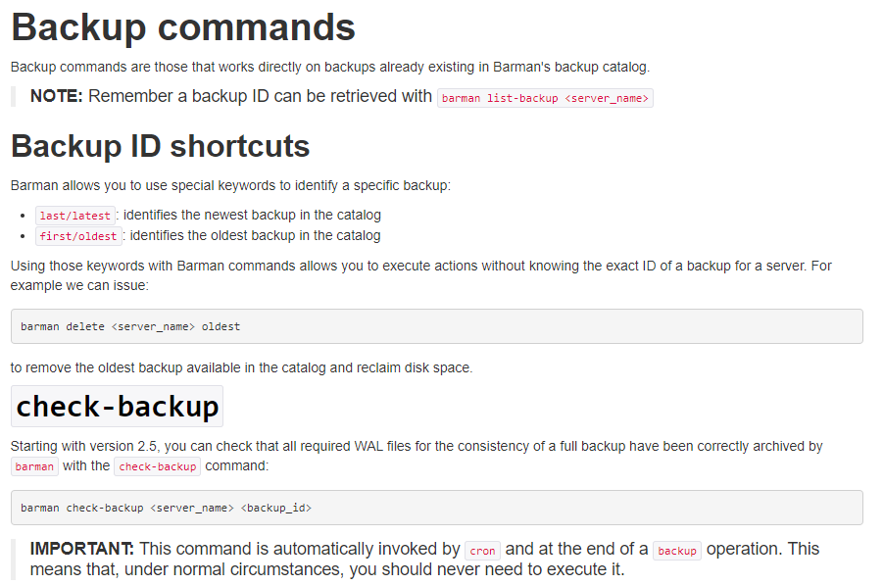

Slide 25
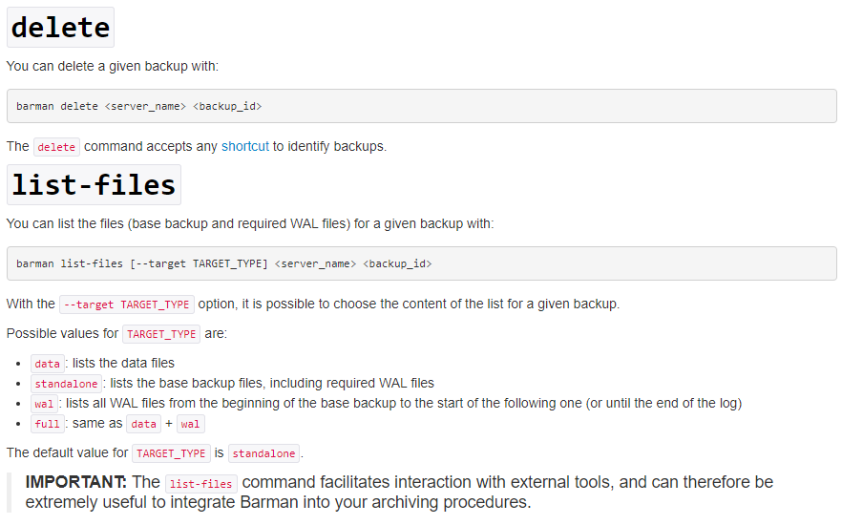

Slide 26
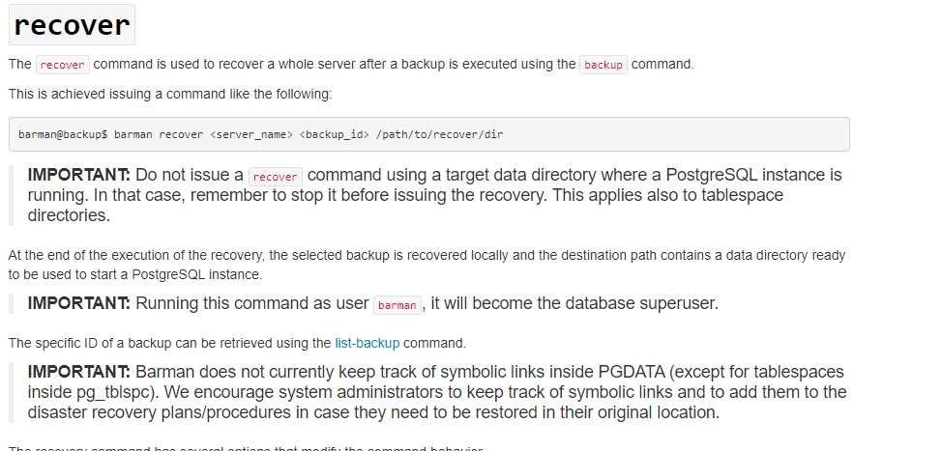

Slide 27
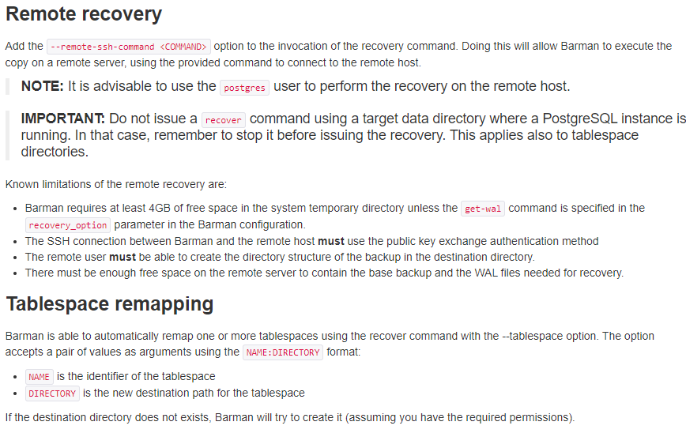

Slide 28
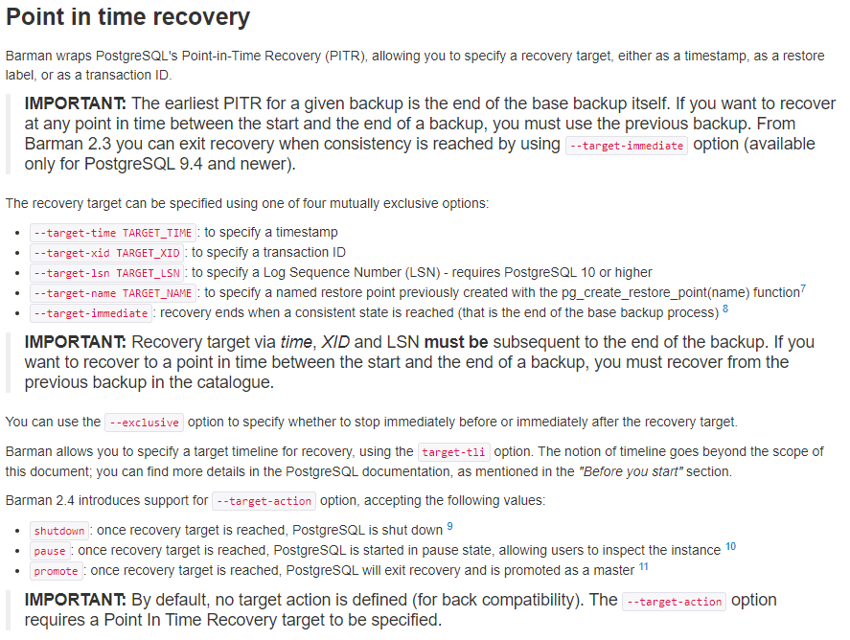

Slide 29
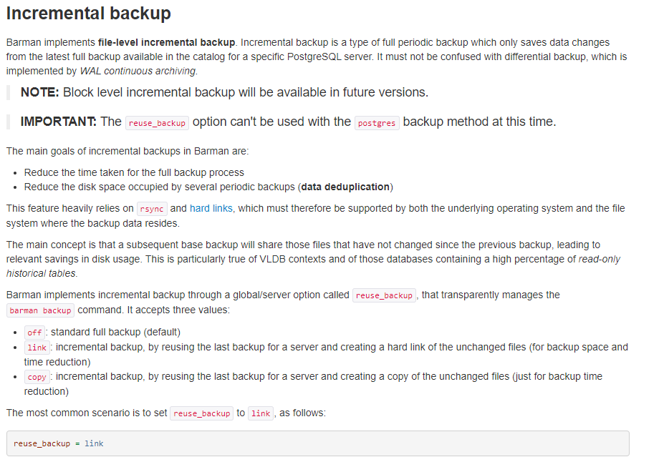

Slide 30
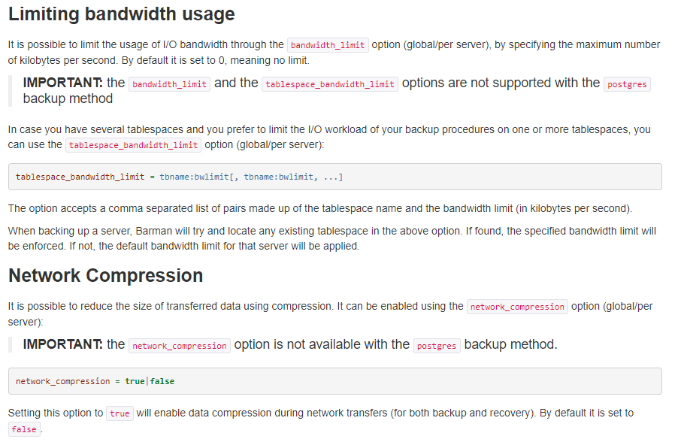

Slide 31
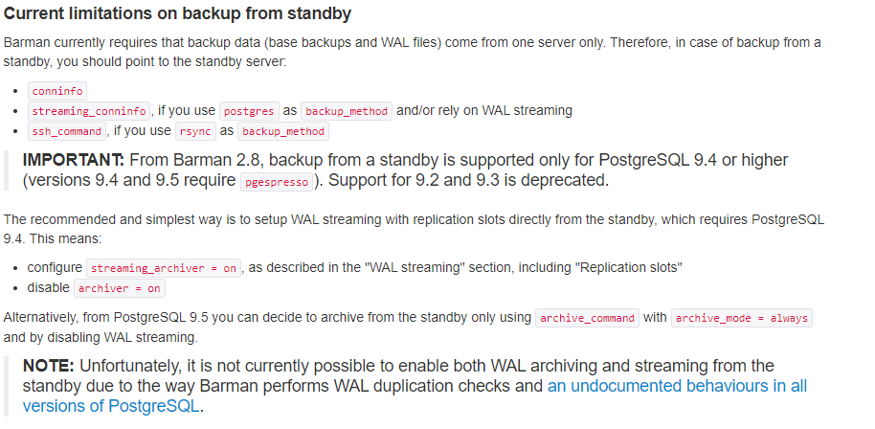

Slide 32
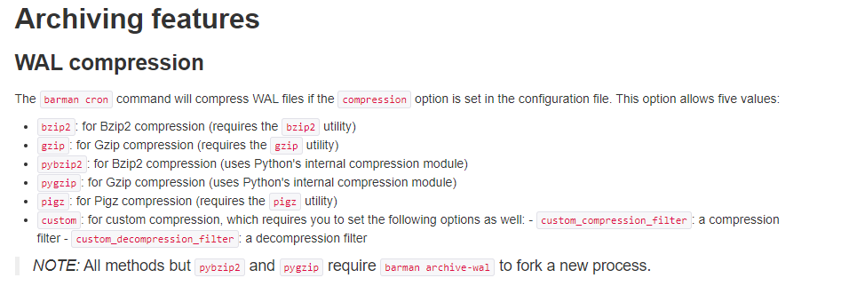

Slide 33
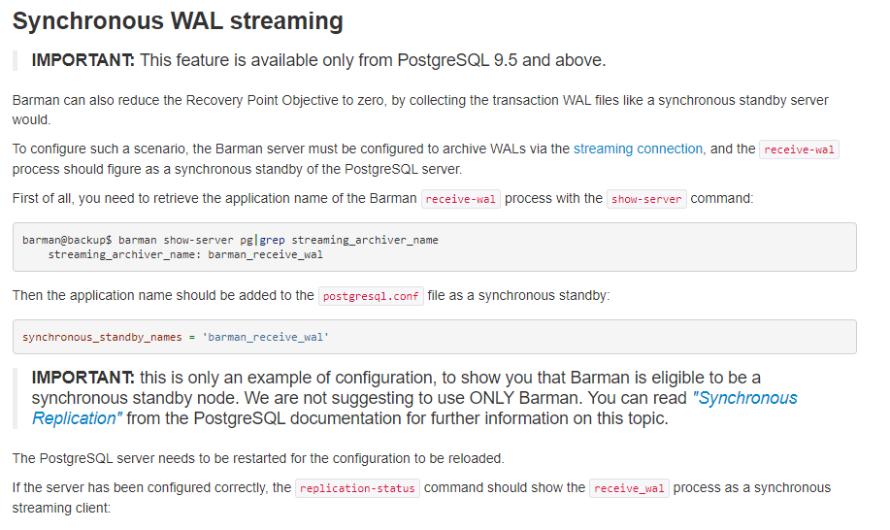

Slide 34
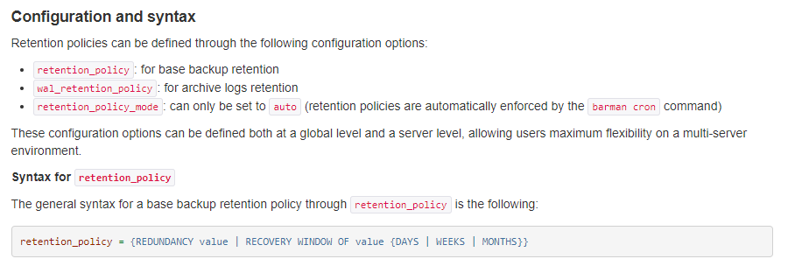

Slide 35
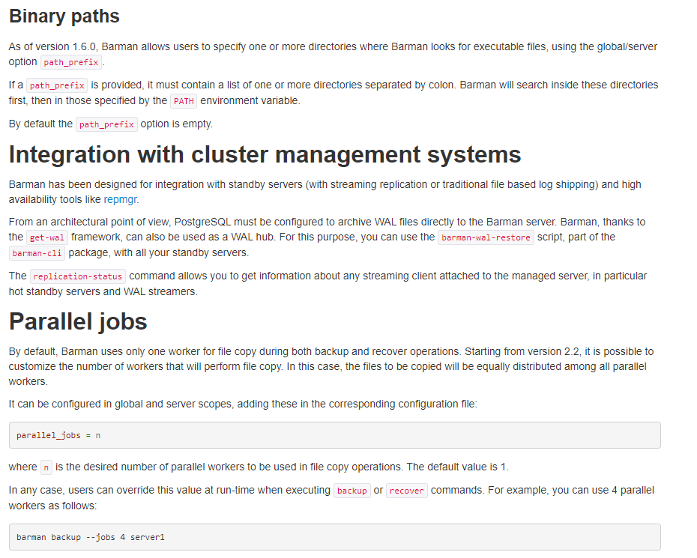

Slide 36
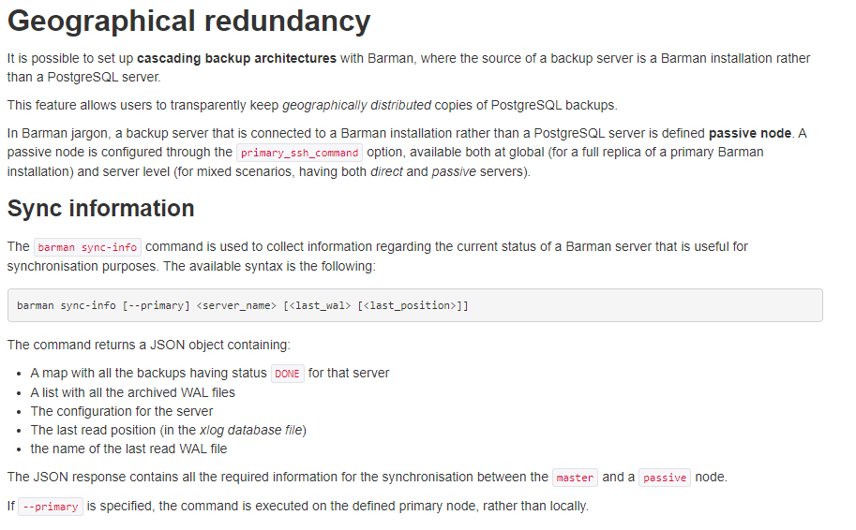

Slide 37
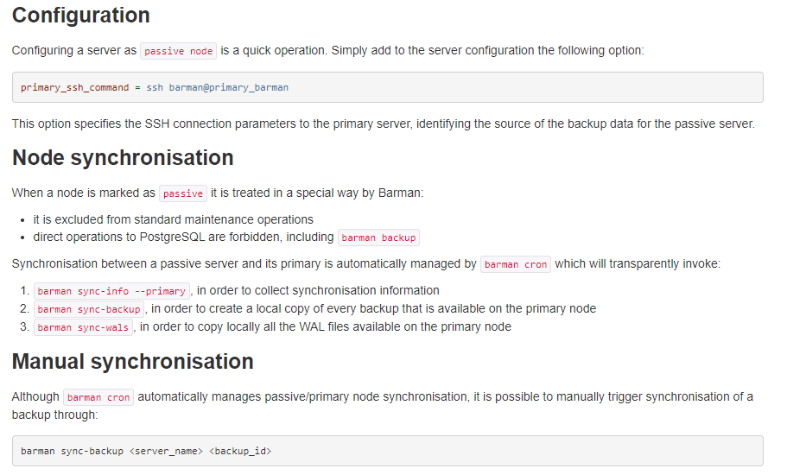

Slide 38
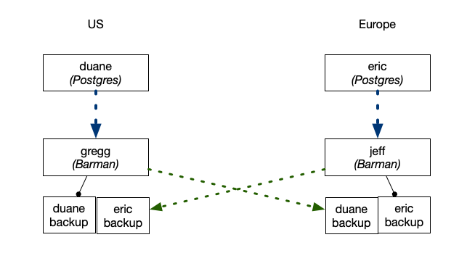

Slide 39
DEMO

